Slide 1
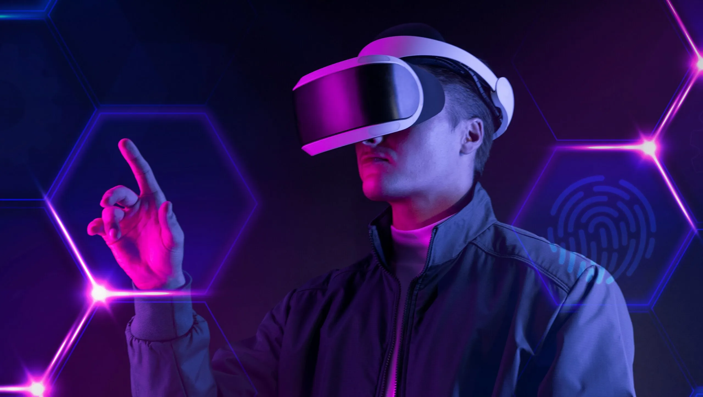
Name : Hamza Sarwar
Roll No : PIAIC202301
Center : UMT (Lahore)
Batch - 39 | Time - 02:00 to 06:00
What is Required to Build Metaverse?

Slide 2
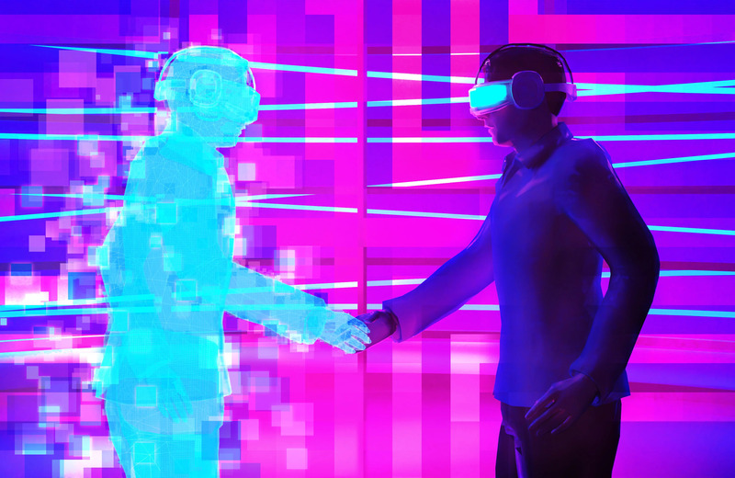
Metaverse Networking
Imagine a virtual world in which people live, work, shop and interact with others all from the comfort of their couch in the physical world. This is known as the metaverse. "Metaverse" didn't become a household term until Facebook changed its corporate name to Meta in October 2021

Slide 3
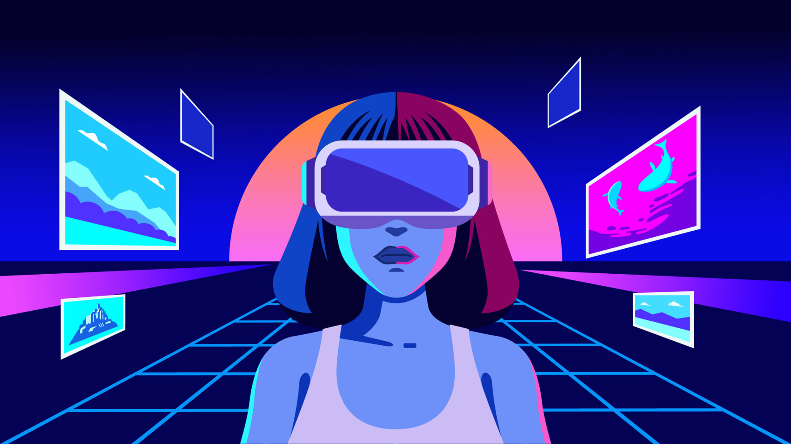
Metaverse Computing
The Metaverse is a hypothetical future version of the internet built around immersive virtual worlds, virtual reality, and augmented reality. It isn't here yet, but the concept is it will allow people to work, play, converse, learn, shop, and more through a unified virtual experience.
In metaverse development, AI is not only a necessary technology in the areas of computer vision and natural language processing, but also in VR and augmented reality (AR).
Most metaverse experiences will not be likely without machine learning (ML) which allows software applications to become more accurate at predicting outcomes without being explicitly programmed to do so.

Slide 4
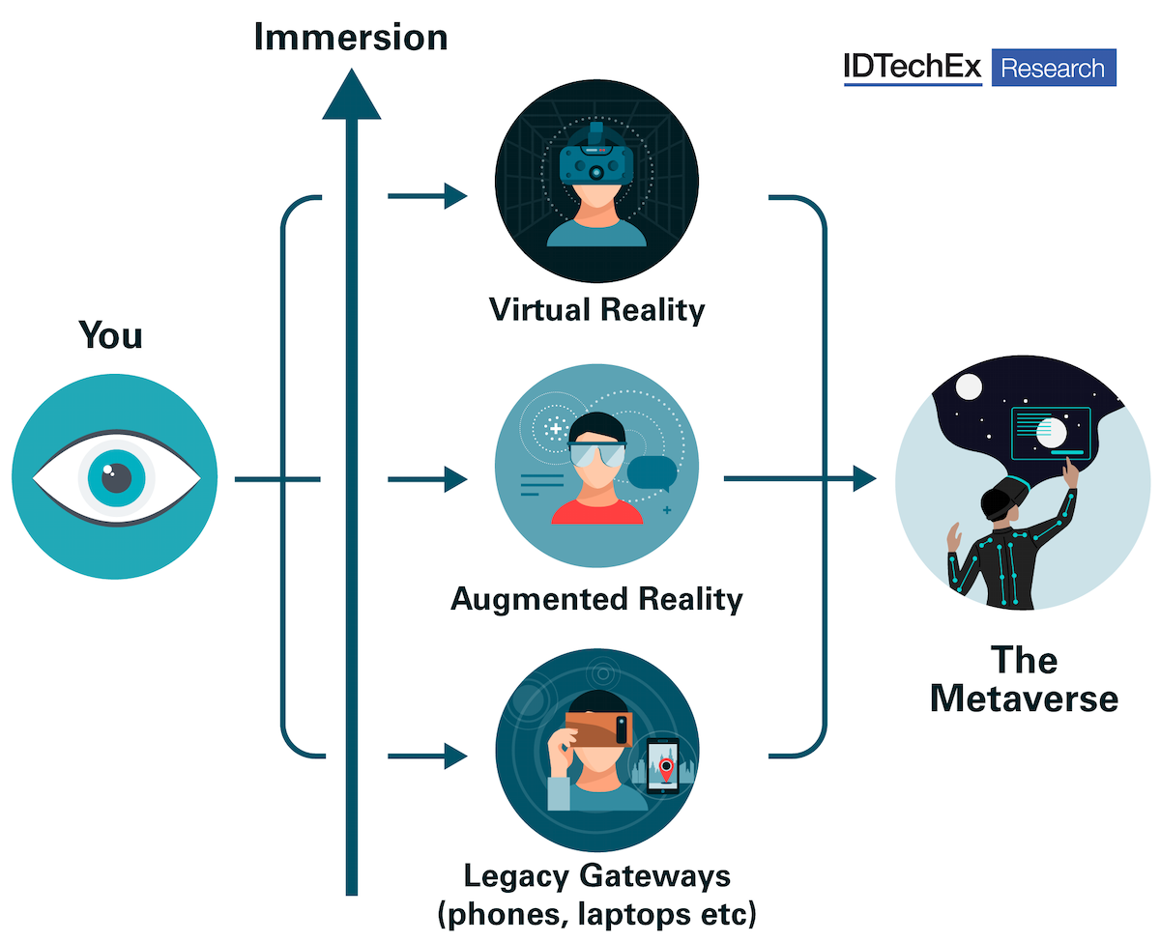
Metaverse Hardware
All it takes is a device with a screen, input system, and a powerful enough processor. In fact, even your computer or smartphone can access the metaverse. It's important to remember that computers and smartphones aren't really designed for the metaverse.
AR and VR have been around for many years and have been extensively used for immersive gaming experiences. The use of these technologies in Metaverse is obvious, and both the Metaverse and immersive tech will continue to evolve.

Slide 5

Blockchain in Metaverse
Blockchain will give metaverse businesses the chance to offer their customers cohesive services that'll converge their physical presence with 3D digital presences, changing how customers interact and exchange cryptocurrencies or other unique digital assets (NFTs).
“No, you don't need blockchain to enable the Metaverse,” he told Cointelegraph. There is no a priori reason why avatars can't be created in 3D and games played with closed platforms, like Second Life's

